Slide 1
Gamma Ray and Anti-Matter Survey (GRAMS)
Power Distribution Unit (PDU)
Time Projection Chamber (TPC) SiPM Power & Telemetry Review

Slide 2
Agenda
The Power Distribution Unit (PDU) for GRAMS is extensive
Only reviewing the Silicon Photo-Multiplier (SiPM) PDU circuitry today
Overview of Requirements for SiPM bias, command & control
Block Diagram
Schematic Review
Grounding Configuration
Layout Review

Slide 3
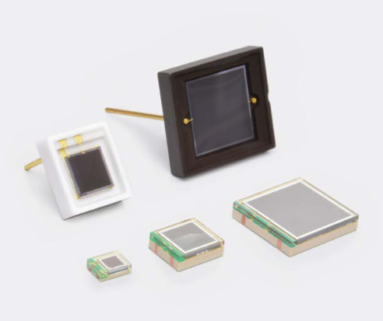
Requirements for TPC SiPM Power
The bias to the SiPMs shall be adjustable
V_{MIN} 43V → V_{MAX} 60V
Bias shall also have Enable / Disable Circuitry
Telemetry Points to measure the Bias and Current
The Current Draw for each SiPM is expected to be 20mA
Temperature Range: -55C to +70C
Target maximum altitude: 36km
Hamamatsu: S13370 Series

Slide 4

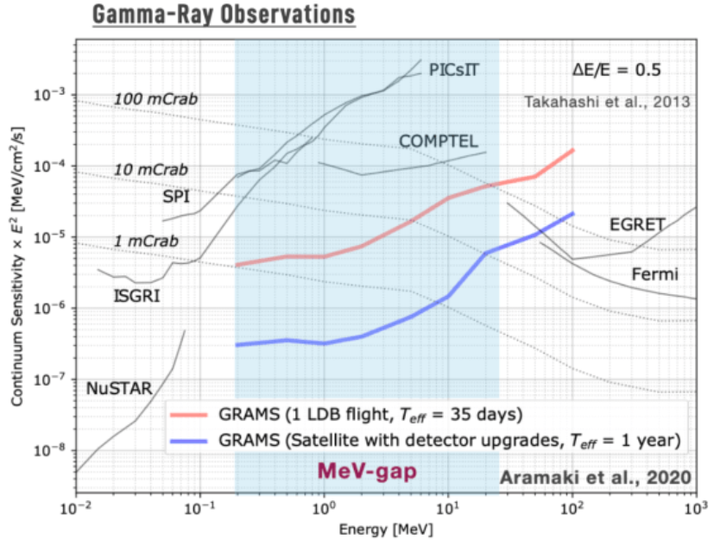
Detector Information and Energy Ranges
Generic bubble chamber image
GRAMS is using a Liquid Argon Time Projection Chamber (LArTPC) to detect the high energy events
High energy particles through the argon will generate scintillated light to be collected by the SiPMs.
Typical bubble chamber operation
Superheated liquid is in the chamber and held just below its boiling point
Interaction with the high energy particles will cause the liquid to boil along its path, creating ‘bubbles’. ☺

Slide 5
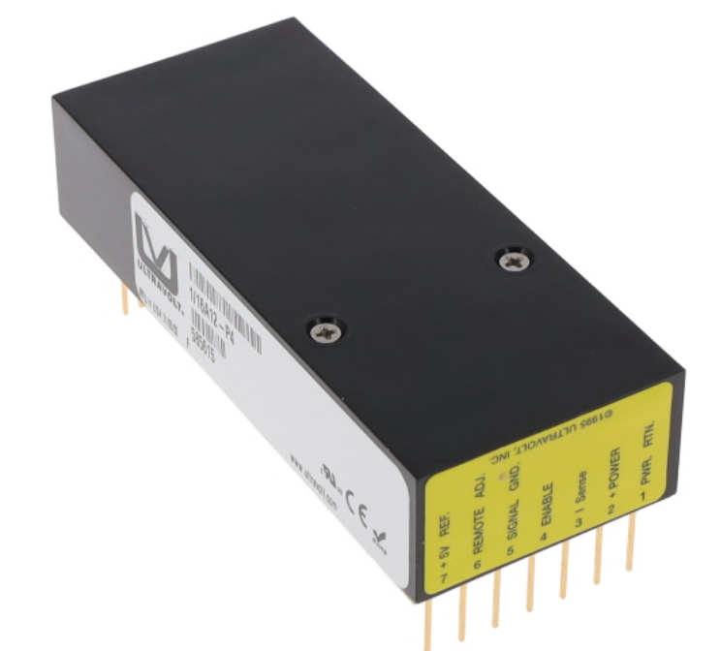
SiPM DC-DC Converter Choice
Ultravolt 1/16A12-P4 DC-DC Converter
Able to supply 62V @ 4W.
60V @ 20mA: 1.2W
Has remote Enable / Disable Feature
Has remote adjust feature for the output voltage

Slide 6
1/16A12-P4 Specifications
Input Parameters of the 1/16A12-P4 Converter
Parameter | Conditions | Values | Units
Input Voltage Range | Full Power | 11 to 16 | Volts
Current | Standby / Disabled | < 30 | mA
Current | Max Load @ output | < 100 | mA
AC Ripple | Max Load @ output | < 80 | mA(peak-peak)
Input Z | Nominal Conditions | 1.1 | MΩ
Enable/Disable Lvl | Nominal Conditions | Disable: 0 to 0.5 | Volts
 |  | Enable: < 2.4
Output Parameters of the 1/16A12-P4 Converter (Vin = 12V)
Parameter | Conditions | Values | Units
Output Power | Max Load @ Output | 4 | Watts
Max Current Output | Entire Output Range | 64 | mA
Output V Ripple | 0.02% of Output V | 1.28 | mV
Temperature Range
Parameter | Maximum (Deg C) | Minimum (Deg C) | Range (Deg C)
Op. (@ Max Load) | -40 | 65 | 105
Storage | -55 | 105 | 160
Applying +12V at the input.
Expecting a current draw of 20mA for each SiPM.
Output Bias will range from 40 to 60V.
Operational Temperature specs assume maximum load conditions

Slide 7
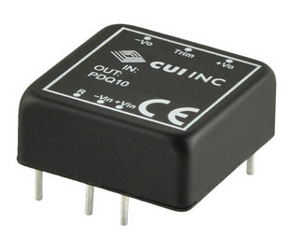
PDQ10-Q24-S5-D DC-DC Converter
Used these on COM-PAIR extensively to great success
Input Parameters of the PDQ10-Q24-S5-D Converter
Parameter | Conditions | Values | Units
Input Voltage Range | Full Power | 9 to 36 | Volts
Current | Maximum Input | 1.4 | A
Current | Max Load @ Input | 1.02 | A
Output Parameters of the 1/16A12-P4 Converter (Vin = 12V)
Parameter | Conditions | Values | Units
Output Power | Max Load @ Output | 10 | Watts
Max Current Output | Entire Output Range | 835 | mA
Output V Ripple | 0.02% of Output V | 100 | mV
Temperature Range
Parameter | Maximum (Deg C) | Minimum (Deg C) | Range (Deg C)
Op. (@ Max Load) | -40 | 105 | 145
Storage | -55 | 125 | 180

Slide 8
Block Diagram of TPC SiPM Box
This box houses 10 boards
One Telemetry Power Board
Nine SiPM Power Boards
Telemetry Board
Provides +12V to each SiPM DC-DC Converter
Provides +5V that drives Telemetry on SiPM Boards
S₁₁
+12V_{IN}
+5V
=
+5V_{RTN}
9 SiPM PDU Boards
+12V_{RTN}
=
S₃₃

Slide 9
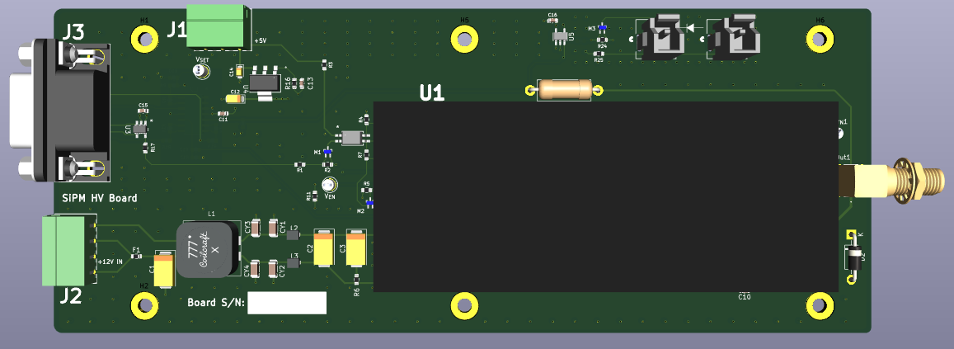
SiPM Power Board
Board Dimensions: 7” x 2.8”

Slide 10
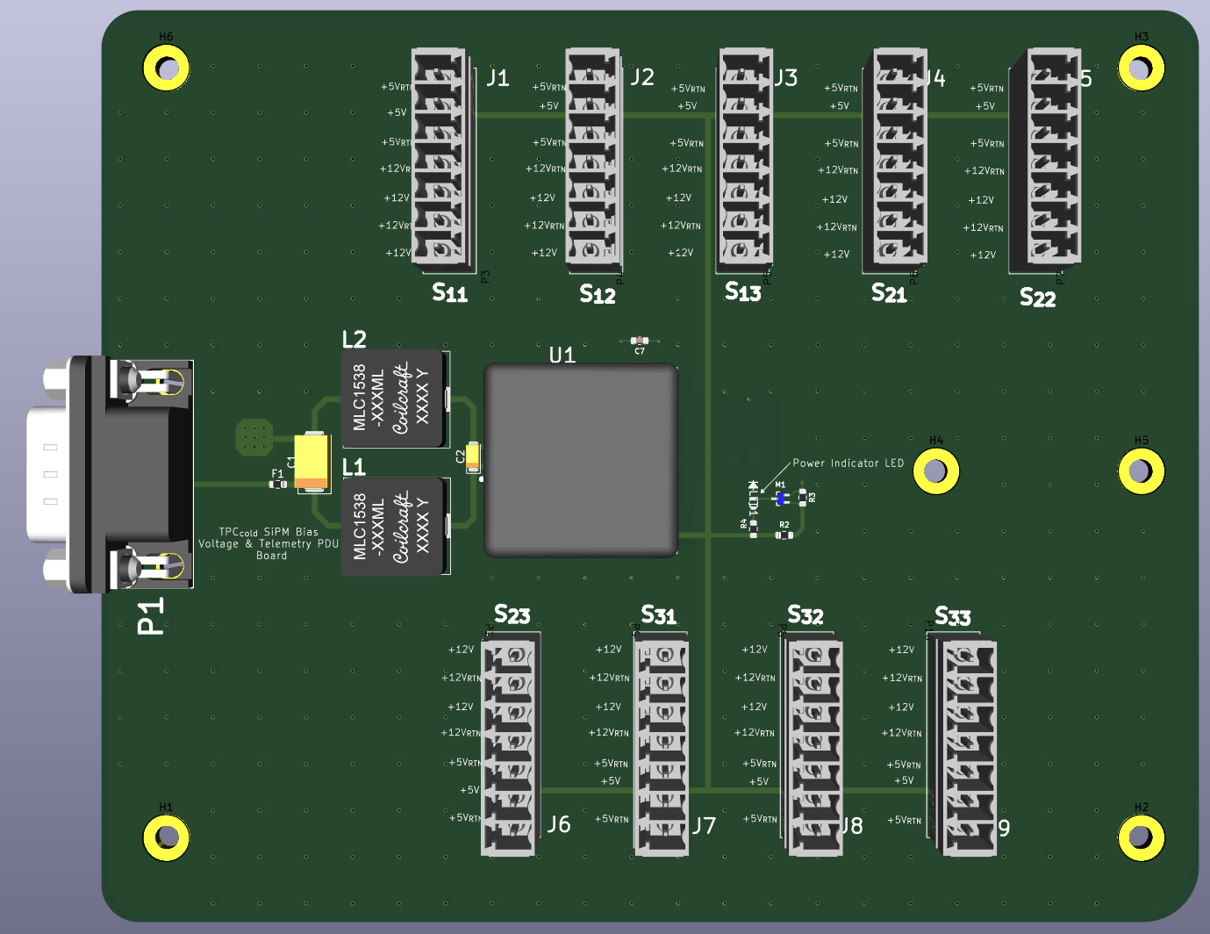
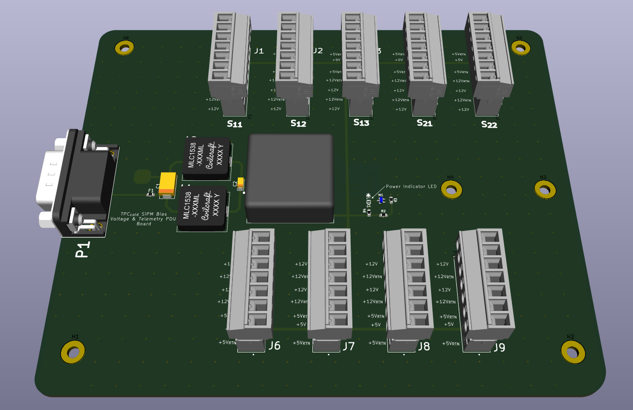
TPC SiPM Telemetry Power Board
Board Dimensions: 5.9” x 4.9”
Wurth Electronik Phoenix Socket: 1803471
Wurth Electronik Phoenix Contact: 1803620

Slide 11
Schematic Review of SiPM Bias Board

Slide 12
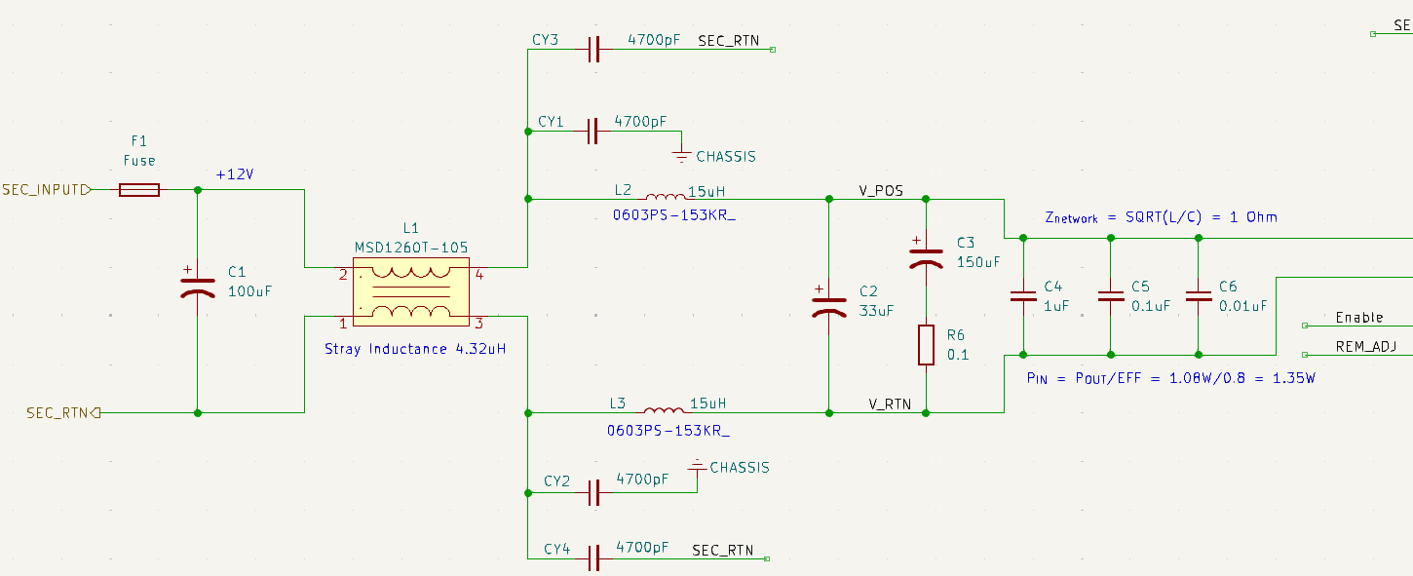
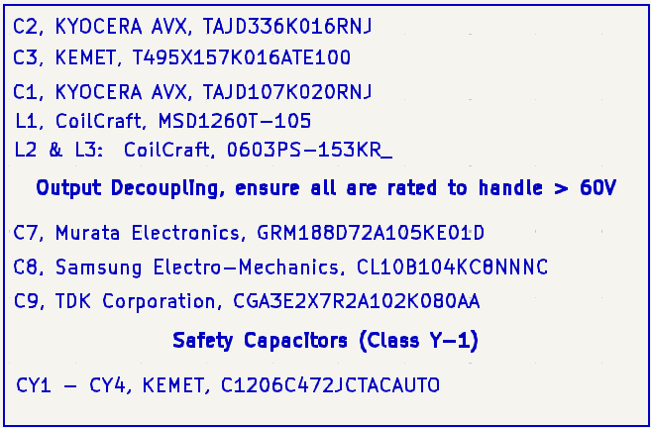
Input EMI/EMC Network

Slide 13
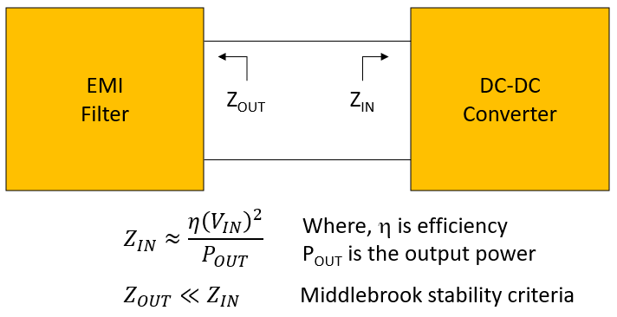








Impedance and Cutoff Frequency of Input Filter
Some Calculations:
$$Z_{{IN}_{min}}=\frac{0.85{\left(12V\right)}^{2}}{4W}=30.6Ω$$
Impedances
$$Z_{Out}≈1.1Ω$$
$$L_{Stray}≈4.32μH$$
$$L_{Total}≈34.32μH$$
$$L_{Diff}=30μH$$
$$C_{Total}≈30μF$$
Frequency
$$f_{c}=\frac{1}{2\left(π\right)\sqrt{LC}}=4.96kHz$$
$$\left(f_{sw}=64kHz\right)$$

Slide 14
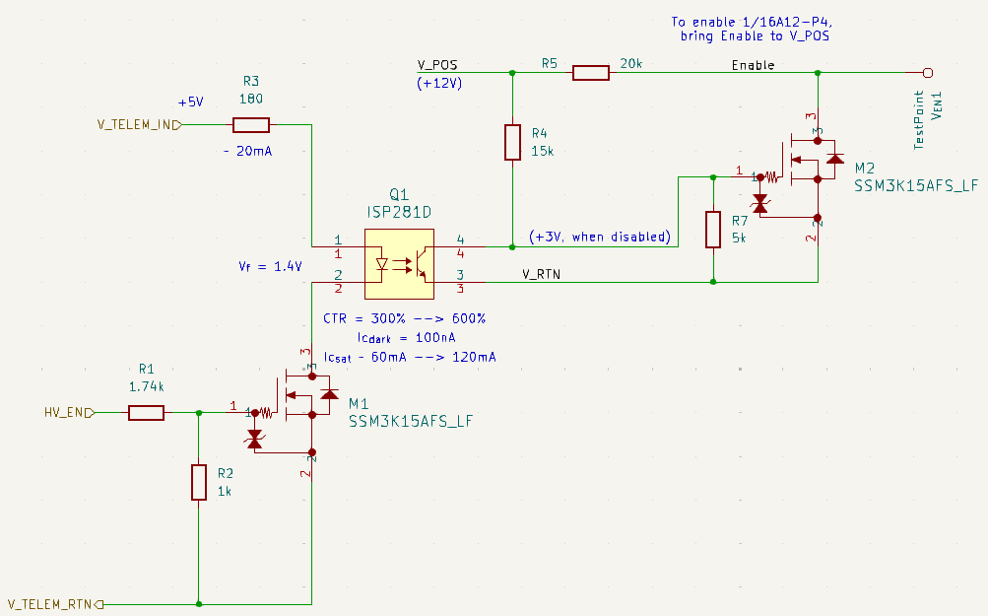
Enable / Disable Circuitry
1/16A12-P4 Enable Signal
There is a 10kΩ Pull-Up resistor internal to the Converter that defaults the block to enabled if no external control circuitry is added.
Am using an opto-coupler to control this function
ISP281D:
Current Transfer Ratio (CTR): 300 to 600%
I_{D} = 100nA
I_{SAT} = 60 to 120mA
Truth Table
HV_EN | Low | High
Enable Line | Low | High
DC-DC Conv. | Disabled | Enabled

Slide 15
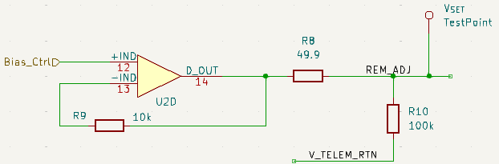
Output Bias Control
Output Bias Control is from external signal
Buffered in (LTC2052HV)
R₁₀ ensures bias is low if Bias_Ctrl is floating
Bias Control Levels
Bias_Ctrl | 0V | 5V
Output Voltage | 0V | 65V

Slide 16
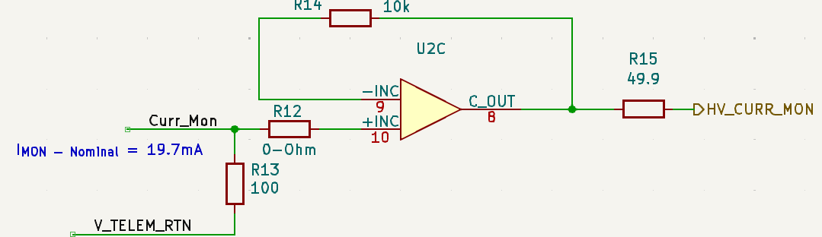
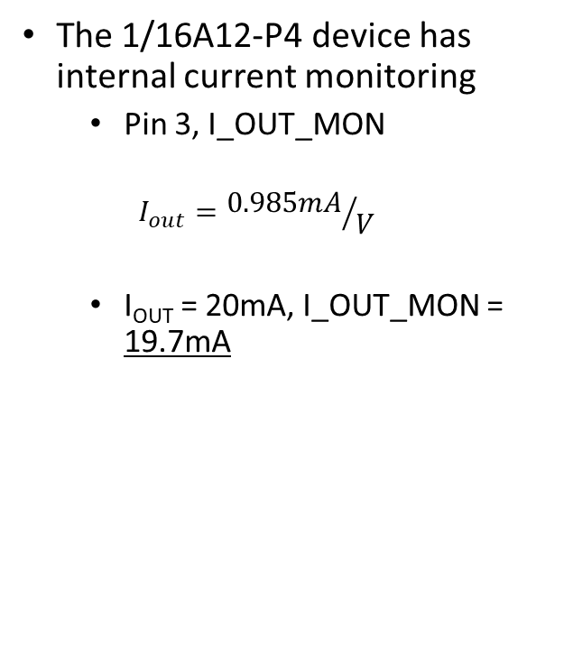
Output Bias Current Monitoring
The 1/16A12-P4 device has internal current monitoring
Pin 3, I_OUT_MON
$$I_{out}={0.985mA}/V$$
I_{OUT} = 20mA, I_OUT_MON = 19.7mA

Slide 17
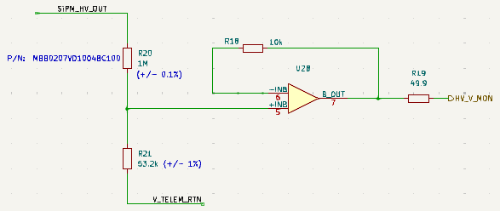
Output Bias Voltage Monitoring
Using a voltage divider and buffering output
1MΩ resistor, (MBB0207VD1004BC100) is capable of dissipating 400mW.
V_{drop} across this resistor is: 57V is the output bias is set to 60V.
P_{D} = 3.3mW
V_{div} = 0.05(Bias Output)
60V will produce 3V at the input of U2B

Slide 18
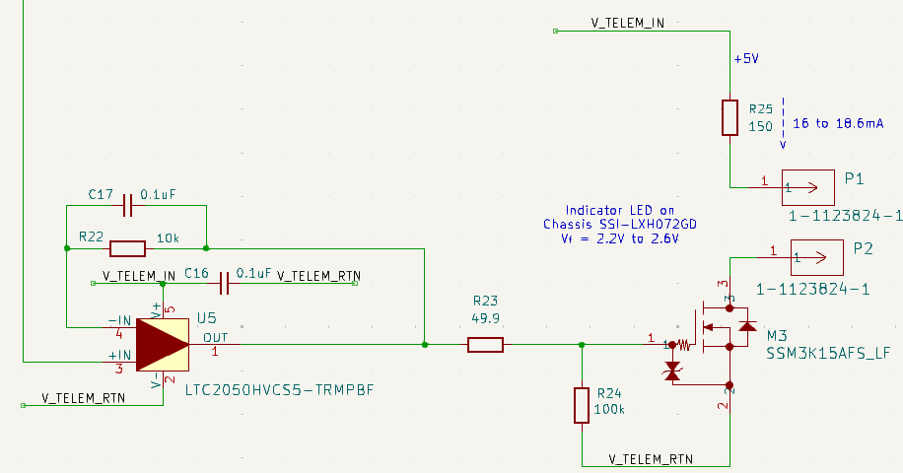
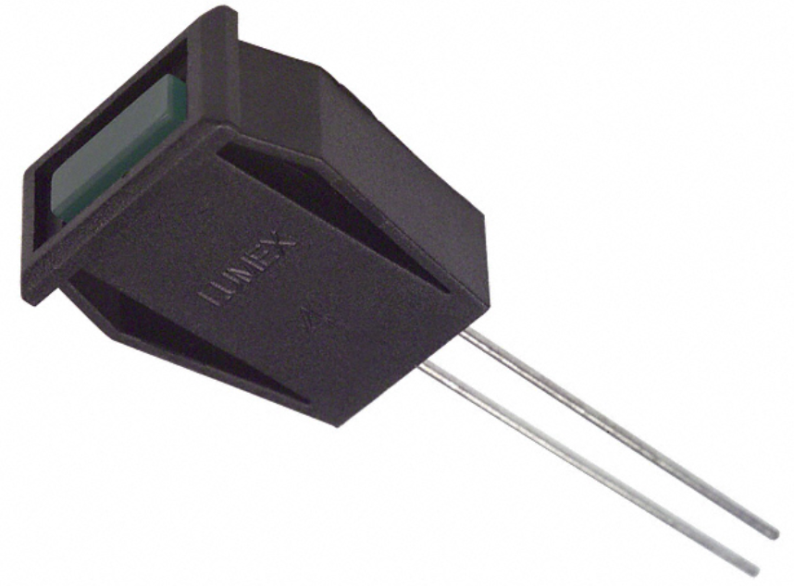
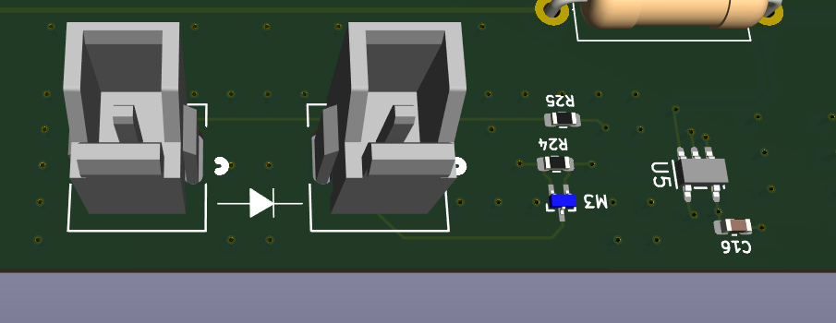
LED Indicator
Part Num: SSI-LXH072GD
+3V @ Bias Level = 60V
+2V @ Bias Level = 40V
Mounted on Chassis
1-1123824-1

Slide 19
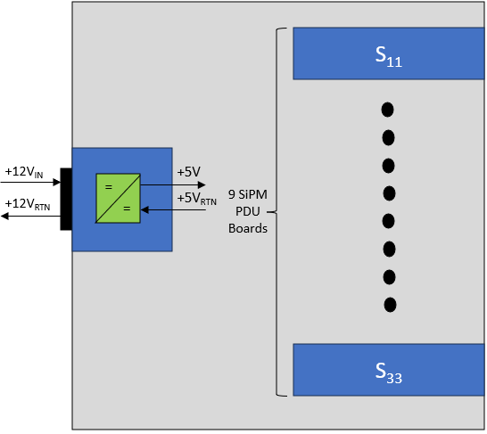


Input Current and Power Calculations
1/16A12-P4
The expected load from each SiPM is approximately 20mA at maximum.
Sub-system testing is on-going.
V_{MIN} 43V → V_{MAX} 60V
Manufacturer quotes efficiency at 90%
$$P_{OUT_Min}=\left(43V\right)\left(0.02A\right)=860mW$$
$$P_{OUT_Max}=\left(60V\right)\left(0.02A\right)=1.2W$$
There are 9 boards pulling this
11.97W_{Total}
0.998A _{Total}
$$P_{IN}={P_{OUT}}/η={1.2W}/{90\%}=1.33W$$
$$i_{IN}=\frac{1.33W}{12V}=111mA$$

Slide 20
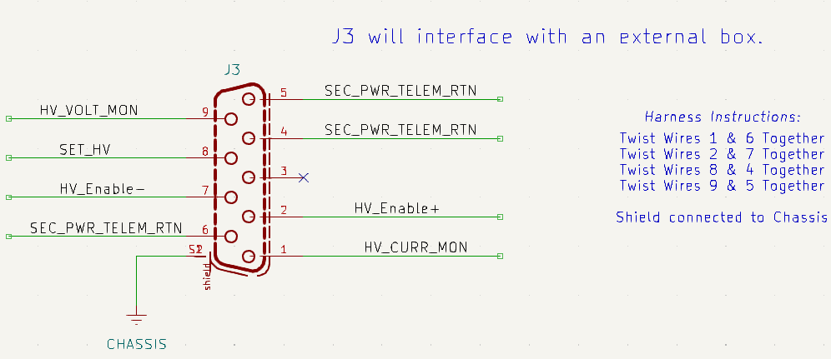
Telemetry I/O
All of the telemetry and control functions are sent and received through J3 (9-Pos Socketed D-SUB)
Enable function is received as a differential signal (LVDS)
U3, SN65LVDS2DBVR receives this signal, delivers to input of optocoupler (Q1)
SEC_PWR_TELEM_RTN is tied to the secondary 5V_RTN on the board.

Slide 21
Grounding Configuration
SiPM Telemetry Power Board
SiPM Power Board
+12V_{IN}
=
+5V_{IN}
V_{12V_RTN}
SiPM_{Bias_RTN}
+12V_{RTN}
=
+5V_{RTN}
J1
SiPM_{Bias}
+12V_{IN}
49.9k
=
+12V_{RTN}
=
SiPM_{Bias_RTN}
J2

Slide 22
Layout Review of SiPM Bias Board

Slide 23
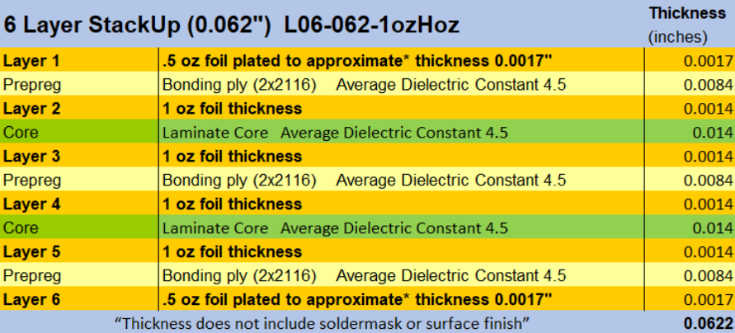
Layer Definition and Stack-Up
6 – Layer Board
Layer 1: Routing
Layer 2: Secondary Power RTN
Layer 3: Power Rails (+5V, +3.3V)
Layer 4: Routing
Layer 5: Secondary Power RTN
Layer 6: Chassis GND
Board Fab House: Sunstone Circuits
Standard 6-Layer Stack up
Not expecting high currents or any high-speed signals

Slide 24
Schematic Review of SiPM Telemetry Power Board

Slide 25
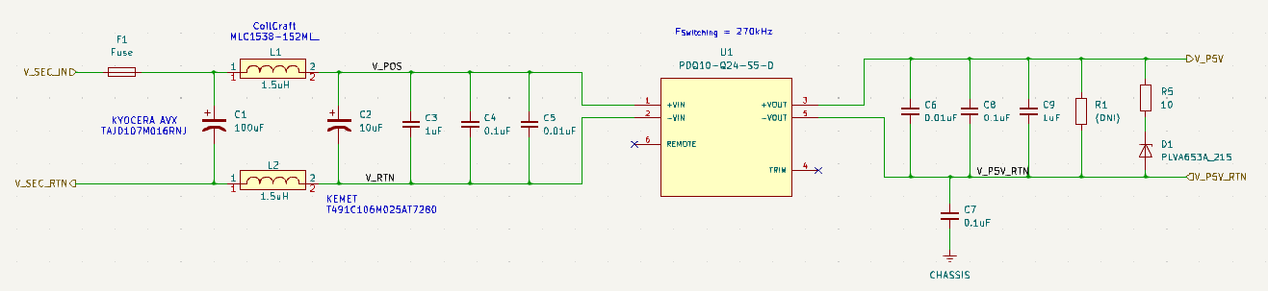
Schematic of DC-DC Converter
PDQ10-Q24-S5-D is manufactured by CUI
Used these extensively on COM-PAIR. No issues were seen.

Slide 26






Impedance and Cutoff Frequency of Input Filter
Some Calculations:
$$Z_{{IN}_{min}}=\frac{0.85{\left(12V\right)}^{2}}{10W}=12.24Ω$$
Impedances
$$Z_{Out}≈0.548Ω$$
$$L_{Total}=3μH$$
$$C_{Total}=10μF$$
Frequency
$$f_{c}=\frac{1}{2\left(π\right)\sqrt{LC}}=29.1kHz$$
$$\left(f_{sw}=240kHz\right)$$

Slide 27
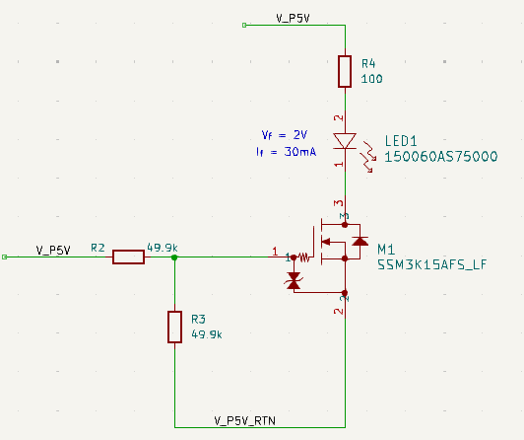
LED Power Indicator
Useful to have a visual indicator if the board is working as designed.
LED will turn on if the +5V is being generated.

Slide 28
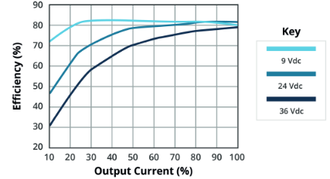




Input Current and Power Calculations
PDQ10-Q24-S5-D
The load from a single SiPM HV Board is ~ 52mA
There are 9 SiPM Boards
Total Current is ~ 470mA
$$P_{OUT}=\left(5V\right)\left(0.47A\right)=2.35W$$
$$P_{IN}={P_{OUT}}/η={2.35W}/{80\%}=2.94W$$
$$i_{IN}=\frac{2.94W}{12V}=245mA$$
$$≈23.5\%$$
Combine this with SiPM HV Board Current:
Total Current Draw: 1.243A _{Total} , 12V
14.92Watts

Slide 29
Layout Review of SiPM Telemetry Power Board

Slide 30
Layer Definition and Stack-Up
6 – Layer Board
Layer 1: Routing
Layer 2: Secondary Power RTN
Layer 3: Secondary Power Rail (+12V_{IN})
Layer 4: Secondary Power Rail (+5V_{RTN})
Layer 5: Secondary Power RTN
Layer 6: Chassis GND
Board Fab House: Sunstone Circuits
Standard 6-Layer Stack up
Not expecting high currents or any high-speed signals

